Slide 1
Local Features
Slides Acknowledgements
Steve Seitz
Kirsten Grauman, Vassilis Athitsos
Other Vision Researchers
Ebook: R. Szeliski

Slide 2

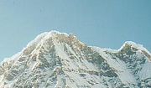

Local features: main components
Detection: Identify the interest points
Description:Extract vector feature descriptor surrounding each interest point.
Matching: Determine correspondence between descriptors in two views
Kristen Grauman

Slide 3
Goal: interest operator repeatability
We want to detect (at least some of) the same points in both images.
Yet we have to be able to run the detection procedure independently per image.
No chance to find true matches!
Notes:
3

Slide 4
History
History of interest point detectors goes a long way back…
Corner detectors
Blob detectors
Edgel detectors

Slide 5
So what’s the novelty?
Local character
Level of invariance
Local invariant features: a new paradigm
Not just a method to select interesting locations in the image, or to speed up analysis
But rather a new image representation, that allows to describe the objects / parts without the need for segmentation

Slide 6
Goal: descriptor distinctiveness
We want to be able to reliably determine which point goes with which.
Must provide some invariance to geometric and photometric differences between the two views.
?

Slide 7
Terminology: Invariant or Covariant?
When a transformation is applied to an image,
an invariant measure remains unchanged.
a covariant measure changes in a way consistent with the image transformation.
Terminology: ‘detector’ or ‘extractor’

Slide 8


The need for invariance

Slide 9
Properties of the ideal feature
Local: features are local, so robust to occlusion and clutter (no prior segmentation)
Invariant (or covariant)
Robust: noise, blur, discretization, compression, etc. do not have a big impact on the feature
Distinctive: individual features can be matched to a large database of objects
Quantity: many features can be generated for even small objects
Accurate: precise localization
Efficient: close to real-time performance
Trevor Darrell

Slide 10
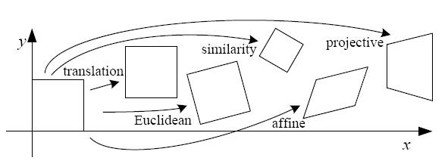
Geometric transformations
Translation
Euclidean (translation + rotation)
Similarity (transl. + rotation + scale)
Affine transformations
Projective transformations
For planar patches:

Slide 11
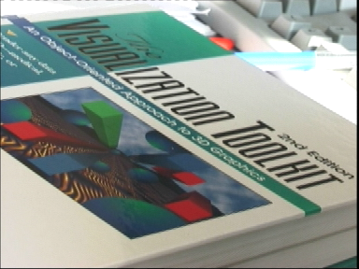
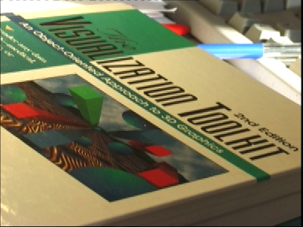
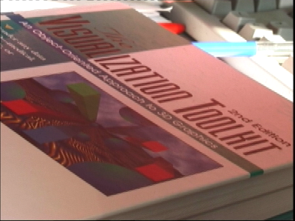
Photometric transformations
Modeled as a linear transformation:
scaling + offset

Slide 12
Disturbances
Noise
Image blur
Discretization errors
Compression artefacts
Deviations from the mathematical model (non-linearities, non-planarities, etc.)
Intra-class variations

Slide 13
How to cope with transformations?
Exhaustive search
Invariance
Robustness

Slide 14
Local features: main components
Detection: Identify the interest points
Description: Extract vector feature descriptor surrounding each interest point.
Matching: Determine correspondence between descriptors in two views

Slide 15
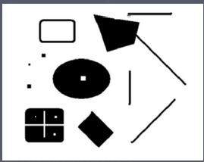
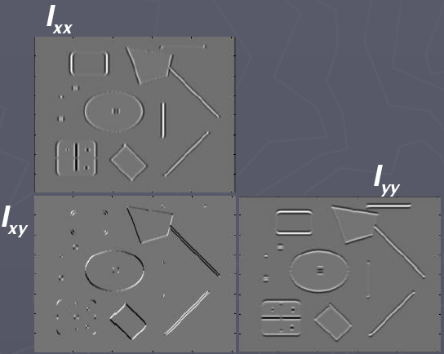
Recall: Corners as
distinctive interest points
2 x 2 matrix of image derivatives (averaged in neighborhood of a point).
Notation:

Slide 16

Recall: Corners as
distinctive interest points
Since M is symmetric, we have
The eigenvalues of M reveal the amount of intensity change in the two principal orthogonal gradient directions in the window.

Slide 17
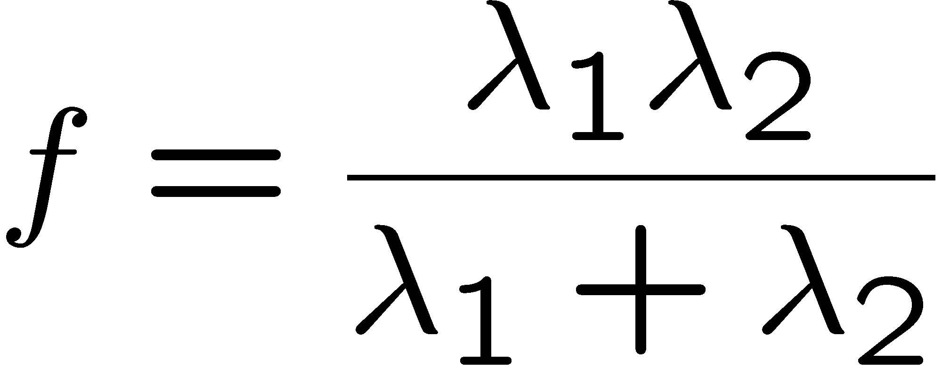
Recall: Corners as
distinctive interest points
“edge”:
“corner”:
“flat” region
λ₁ >> λ₂
λ₁ and λ₂ are large, λ₁ ~ λ₂;
λ₁ and λ₂ are small;
λ₂ >> λ₁
One way to score the cornerness:

Slide 18
Harris corner detector
Compute M matrix for image window surrounding each pixel to get its cornerness score.
Find points with large corner response (f > threshold)
Take the points of local maxima, i.e., perform non-maximum suppression
Notes:
18

Slide 19

Harris Detector: Steps

Slide 20

Harris Detector: Steps
Compute corner response f

Slide 21

Harris Detector: Steps
Find points with large corner response: f > threshold

Slide 22
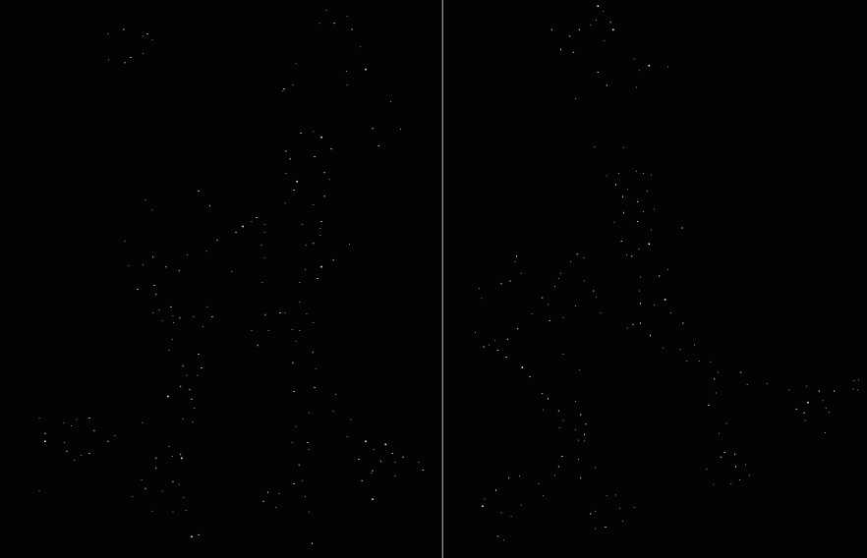
Harris Detector: Steps
Take only the points of local maxima of f

Slide 23

Harris Detector: Steps

Slide 24
Properties of the Harris corner detector
Rotation invariant?
Scale invariant?
Yes

Slide 25
Properties of the Harris corner detector
Rotation invariant?
Scale invariant?
Yes
No
All points will be classified as edges
Corner !

Slide 26
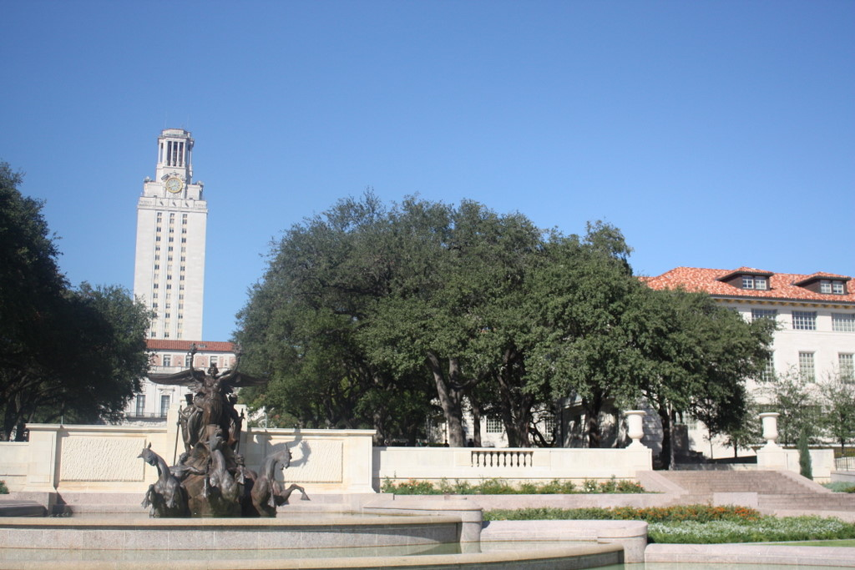
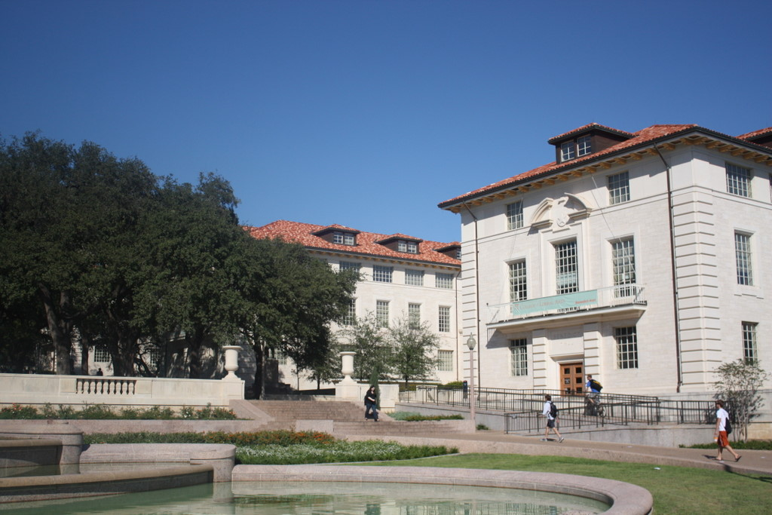
Scale invariant interest points
How can we independently select interest points in each image, such that the detections are repeatable across different scales?

Slide 27
Automatic scale selection
Intuition:
Find scale that gives local maxima of some function f in both position and scale.
f
f
Image 1
Image 2
s₁
region size
s₂
region size

Slide 28
What can be the “signature” function?

Slide 29
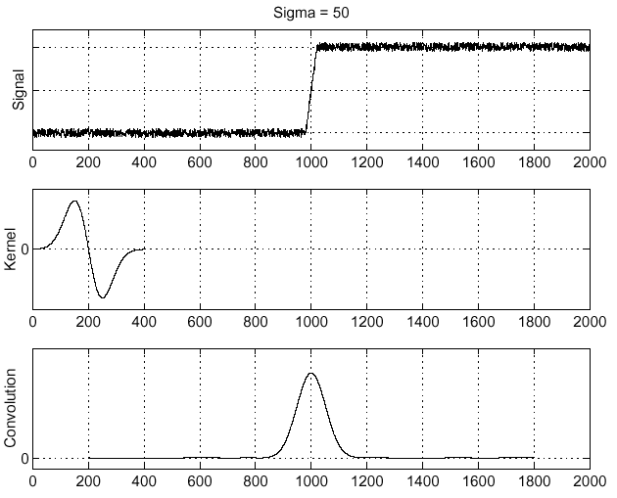
Recall: Edge detection
Edge
f
Derivative of Gaussian
Edge = maximum of derivative
Source: S. Seitz

Slide 30
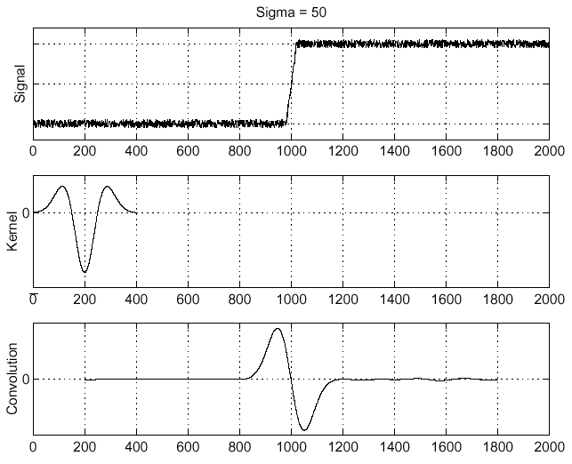
Recall: Edge detection
f
Edge
Second derivative of Gaussian (Laplacian)
Edge = zero crossing of second derivative
Source: S. Seitz

Slide 31
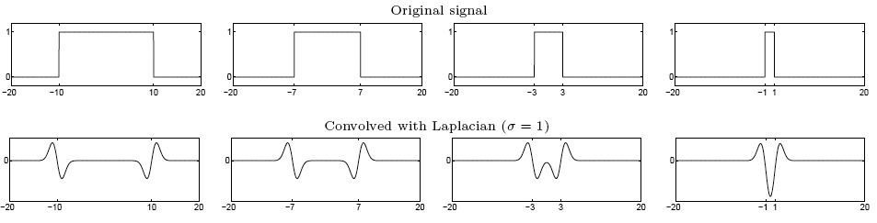
From edges to blobs
Edge = ripple
Blob = superposition of two ripples
maximum
Spatial selection: the magnitude of the Laplacian response will achieve a maximum at the center of the blob, provided the scale of the Laplacian is “matched” to the scale of the blob
Slide credit: Lana Lazebnik

Slide 32
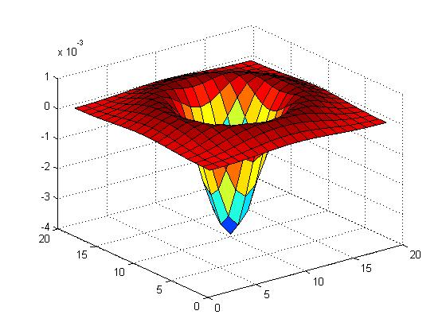

Blob detection in 2D
Laplacian of Gaussian: Circularly symmetric operator for blob detection in 2D

Slide 33
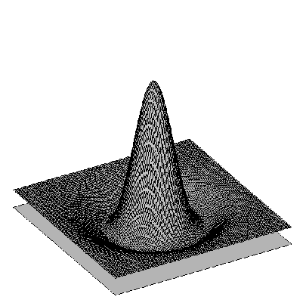

Blob detection in 2D: scale selection
Laplacian-of-Gaussian = “blob” detector
filter scales
img2
img1
img3
Bastian Leibe

Slide 34
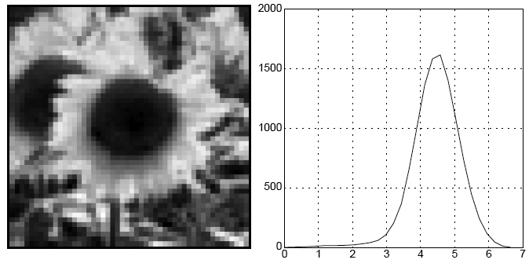
Blob detection in 2D
We define the characteristic scale as the scale that produces peak of Laplacian response
characteristic scale
Slide credit: Lana Lazebnik

Slide 35
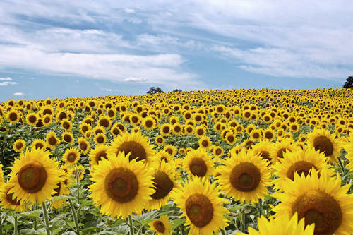
Example
Original image at ¾ the size
Kristen Grauman

Slide 36
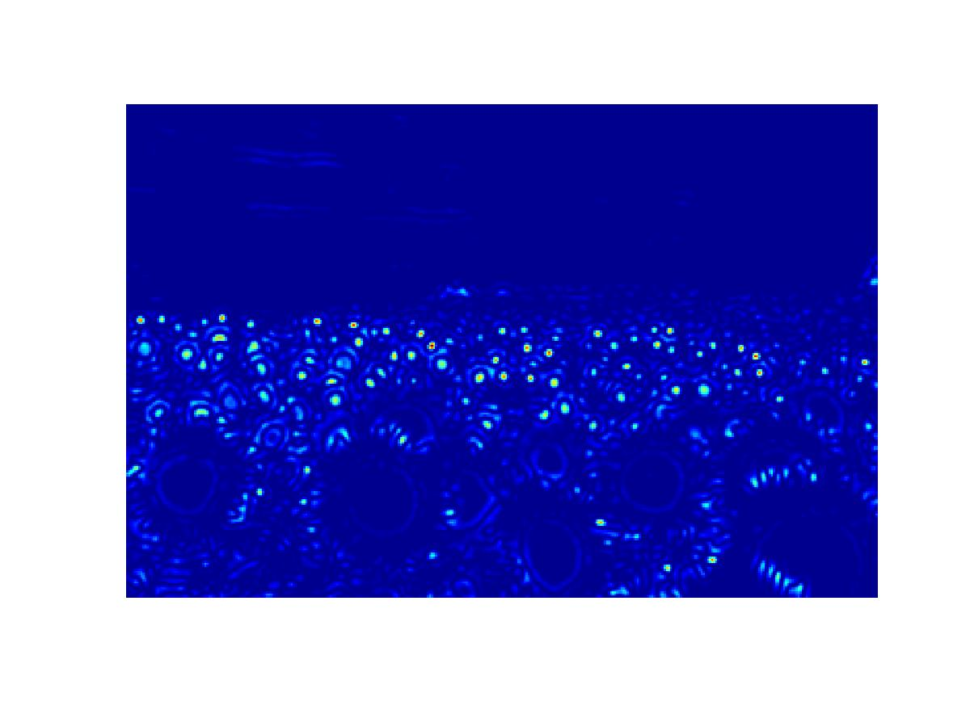
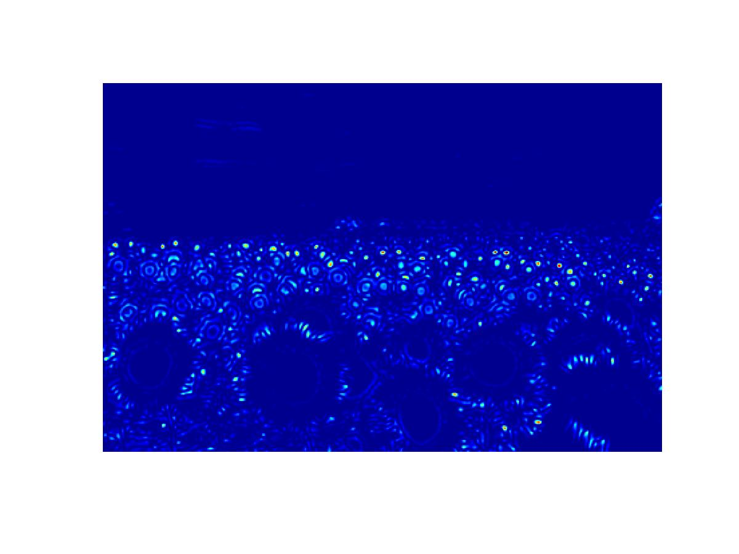
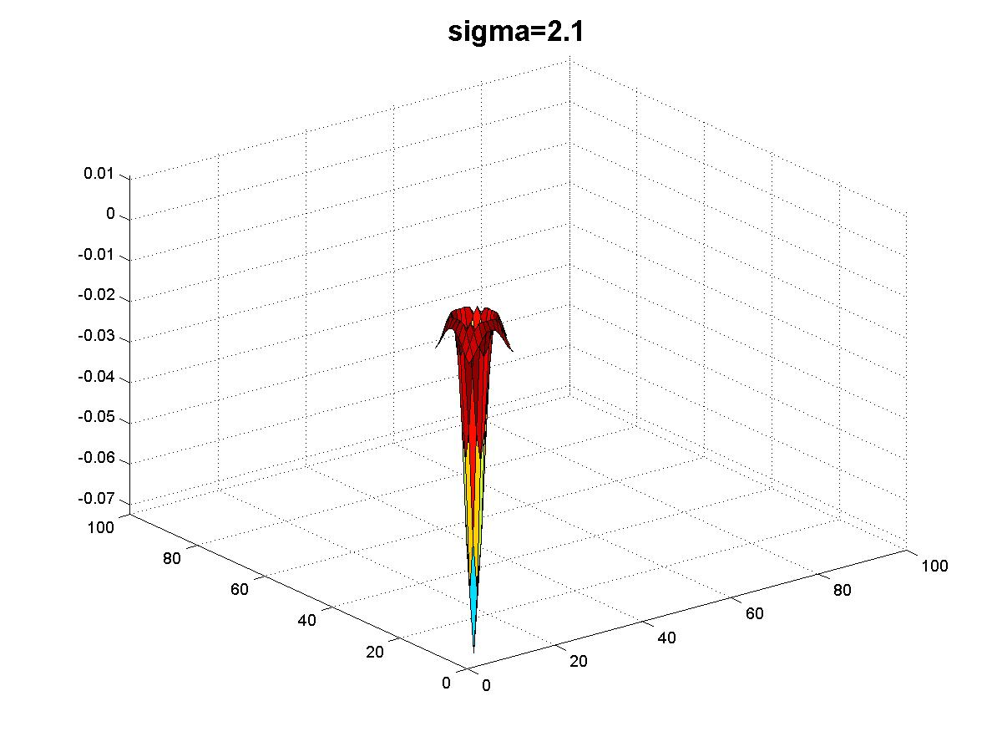
Original image at ¾ the size
Kristen Grauman

Slide 37
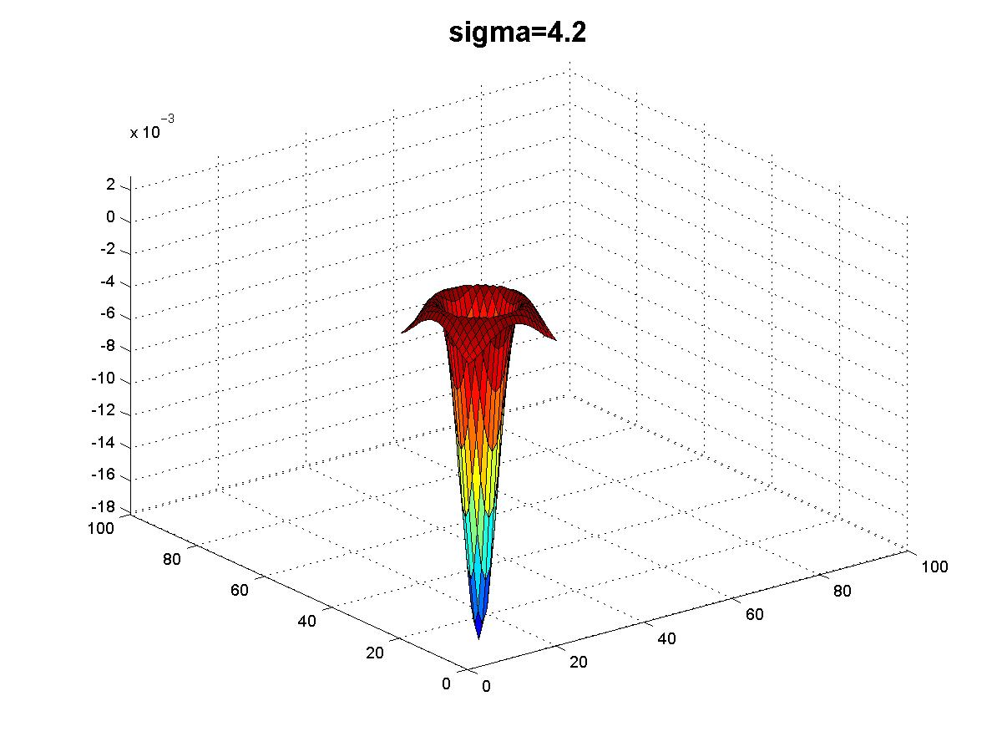
Original image at ¾ the size
Kristen Grauman

Slide 38
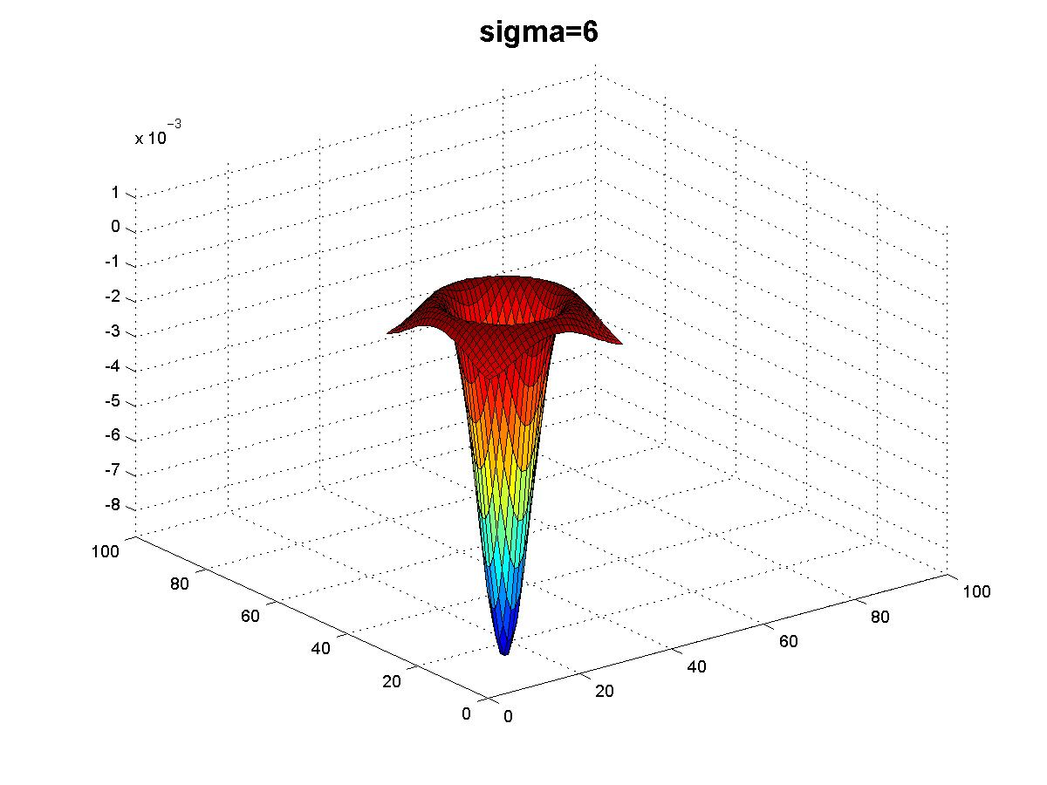
Original image at ¾ the size
Kristen Grauman

Slide 39
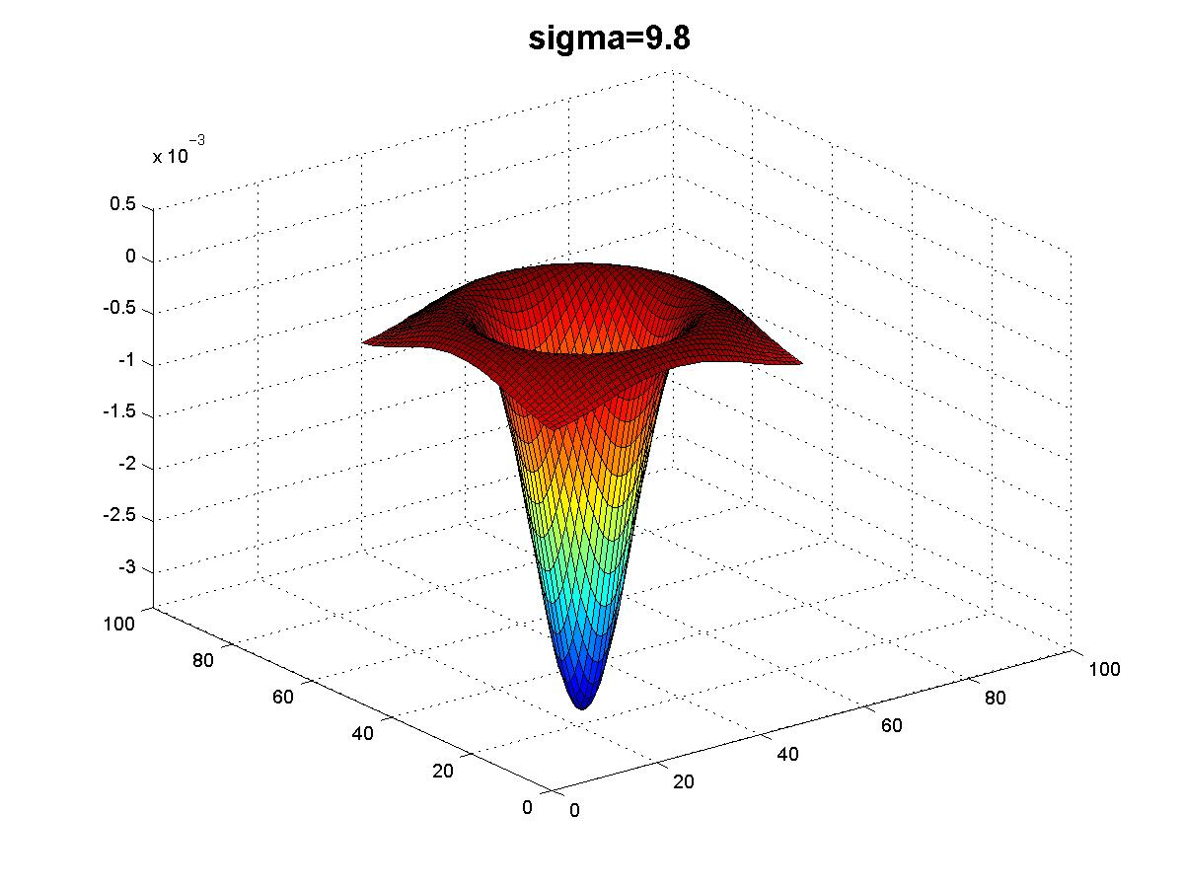
Original image at ¾ the size
Kristen Grauman

Slide 40
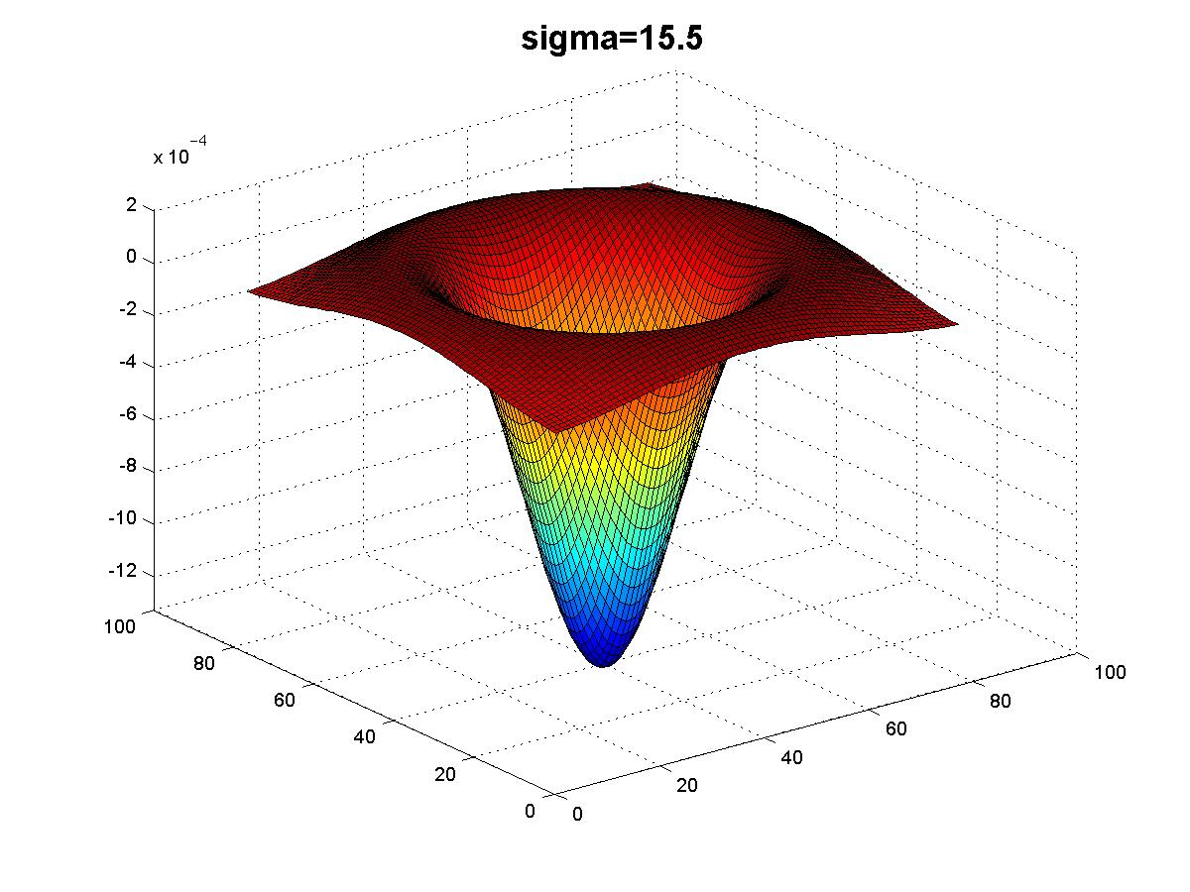
Original image at ¾ the size
Kristen Grauman

Slide 41
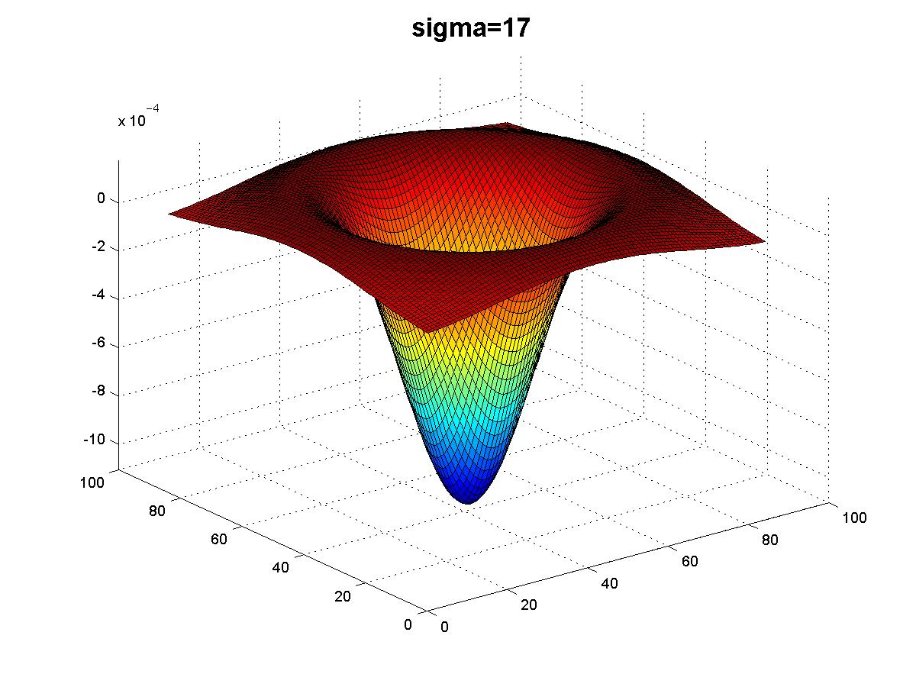
Original image at ¾ the size
Kristen Grauman

Slide 42
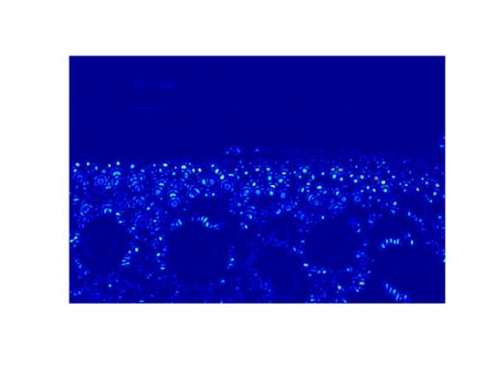
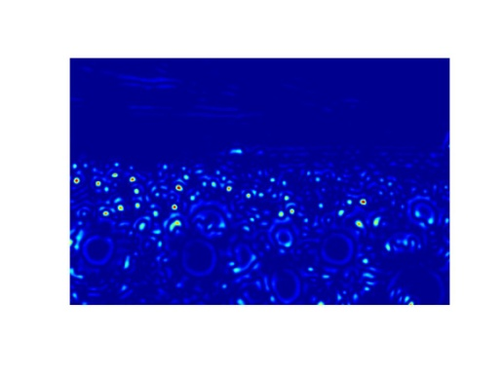
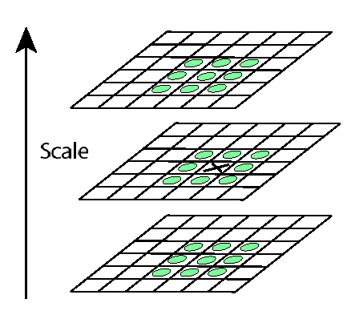
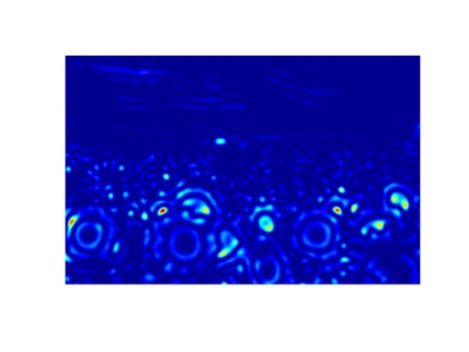
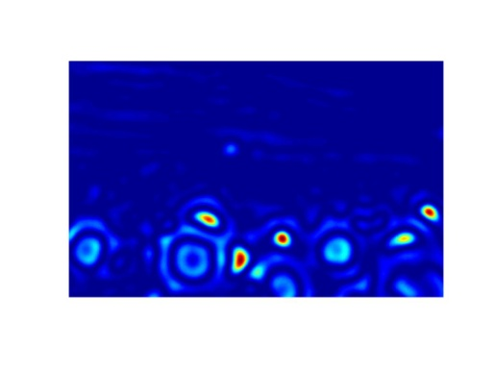
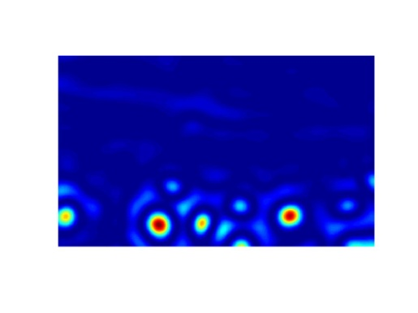
Scale invariant interest points
Interest points are local maxima in both position and scale.
σ5
σ4
scale
σ3
σ2
⇒ List of (x, y, σ)
Squared filter response maps
σ1

Slide 43
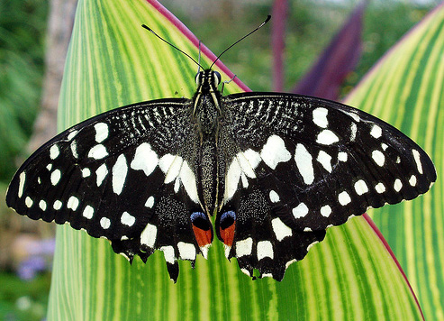
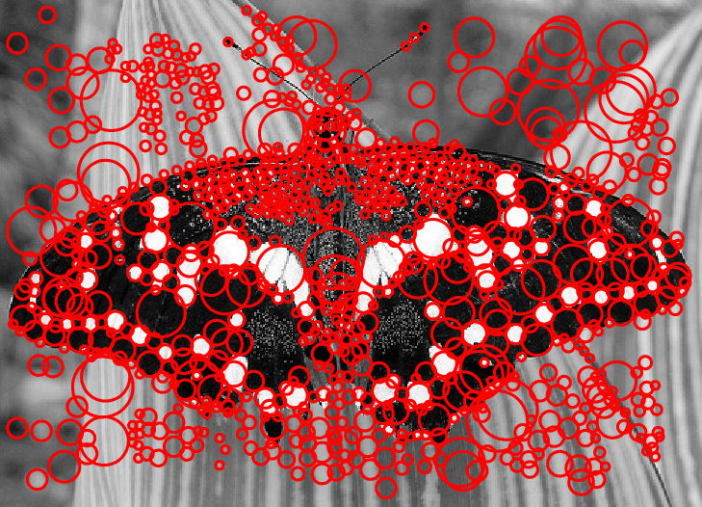
Scale-space blob detector: Example
Image credit: Lana Lazebnik

Slide 44
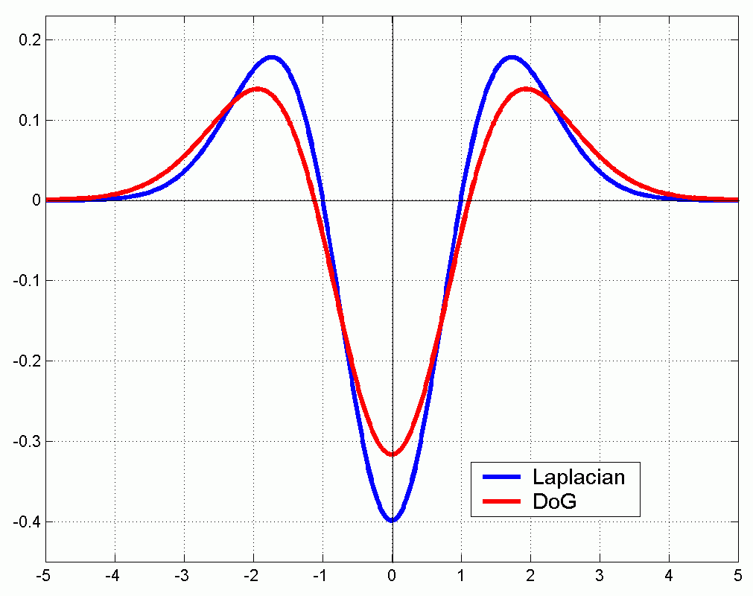
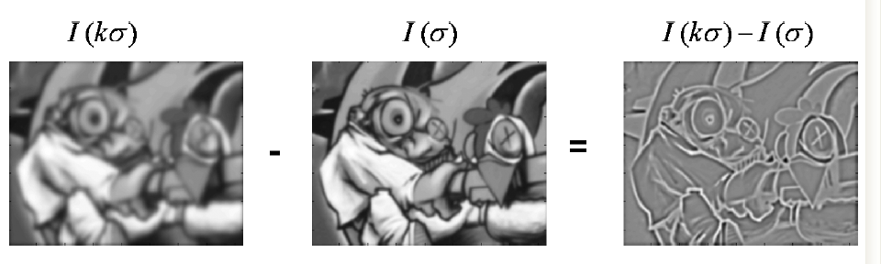
Technical detail
We can approximate the Laplacian with a difference of Gaussians; more efficient to implement.
(Laplacian)
(Difference of Gaussians)

Slide 45
Local features: main components
Detection: Identify the interest points
Description:Extract vector feature descriptor surrounding each interest point.
Matching: Determine correspondence between descriptors in two views

Slide 46




Geometric transformations
e.g. scale, translation, rotation

Slide 47
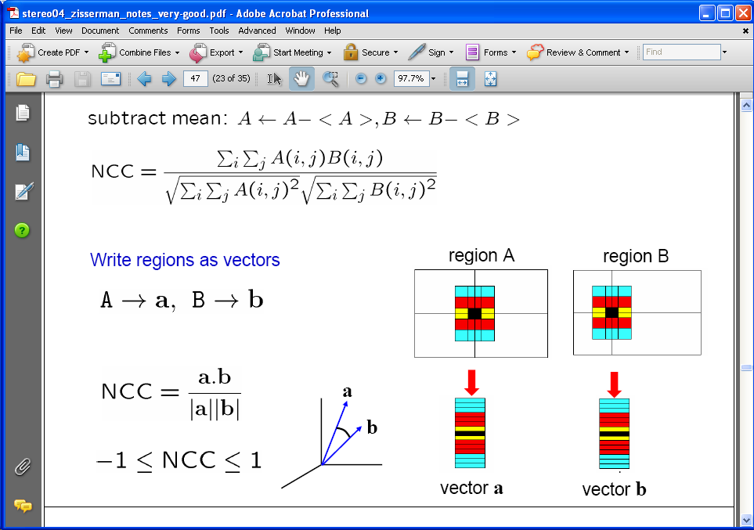
Raw patches as local descriptors
The simplest way to describe the neighborhood around an interest point is to write down the list of intensities to form a feature vector.
But this is very sensitive to even small shifts, rotations.

Slide 48

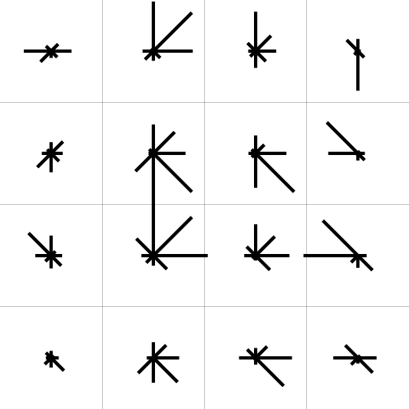
SIFT descriptor [Lowe 2004]
Use histograms to bin pixels within sub-patches according to their orientation.
0
2
π
Why subpatches?
Why does SIFT have some illumination invariance?

Slide 49
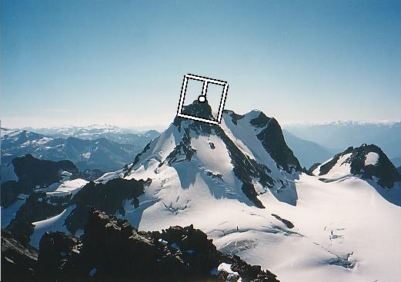
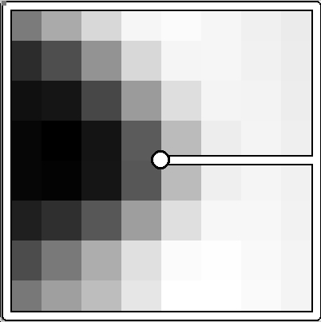
Making descriptor rotation invariant
CSE 576: Computer Vision
Rotate patch according to its dominant gradient orientation
This puts the patches into a canonical orientation.
Image from Matthew Brown

Slide 50
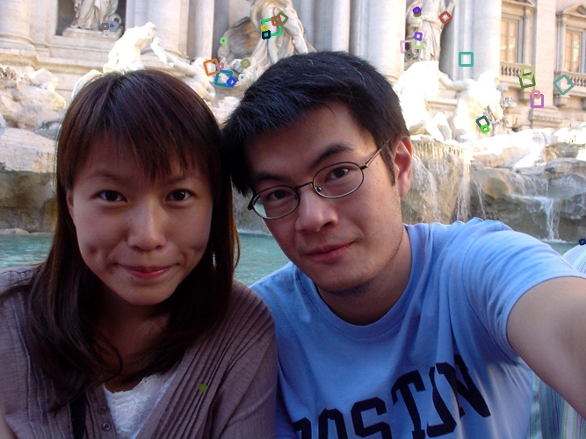
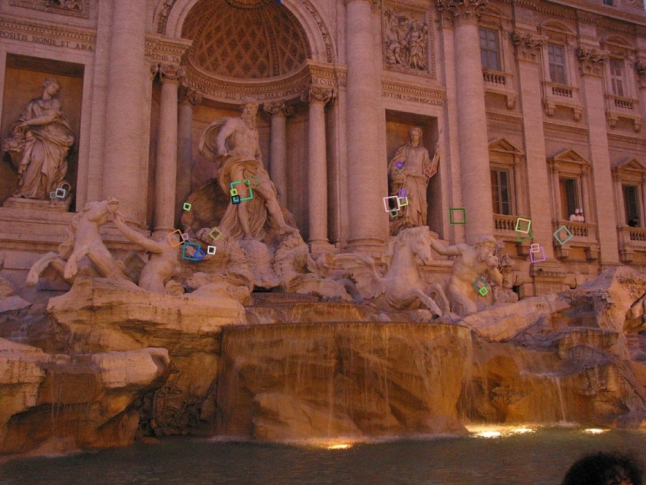
SIFT descriptor [Lowe 2004]
Extraordinarily robust matching technique
Can handle changes in viewpoint
Up to about 60 degree out of plane rotation
Can handle significant changes in illumination
Sometimes even day vs. night (below)
Fast and efficient—can run in real time
Lots of code available
http://people.csail.mit.edu/albert/ladypack/wiki/index.php/Known_implementations_of_SIFT
Steve Seitz

Slide 51
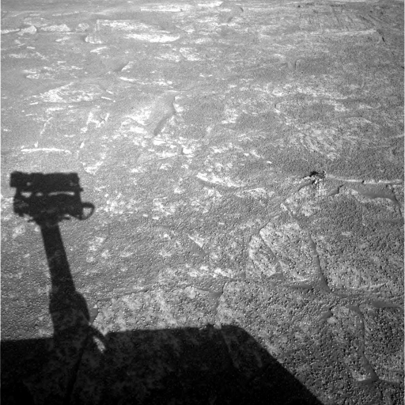
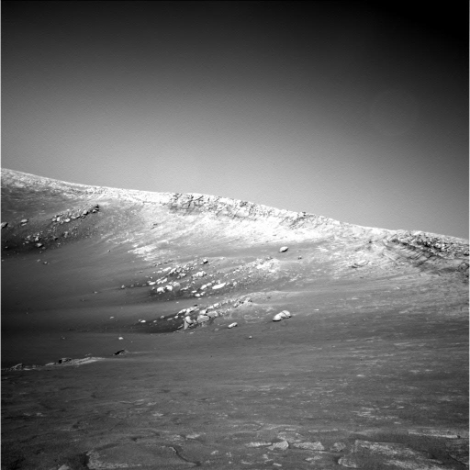
Example
NASA Mars Rover images

Slide 52
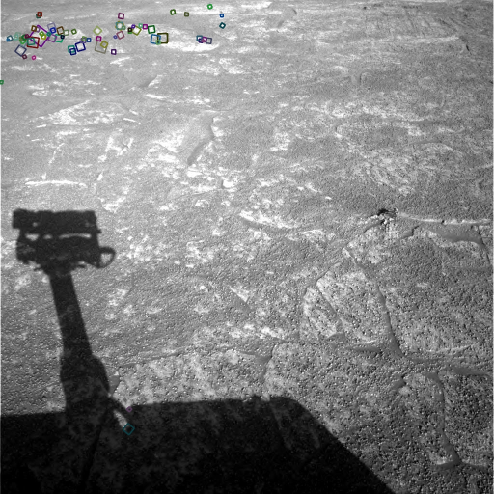
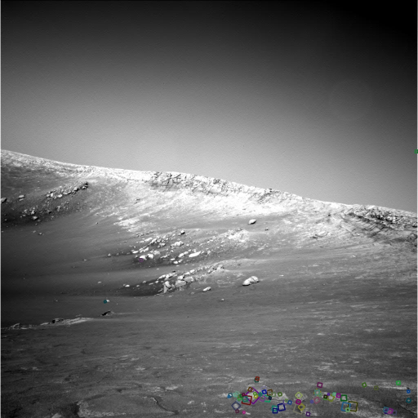
Example
NASA Mars Rover images
with SIFT feature matches Figure by Noah Snavely

Slide 53
SIFT Properties
Invariant to
Scale
Rotation
Partially invariant to
Illumination changes
Camera viewpoint
Occlusion, clutter

Slide 54
Local features: main components
Detection: Identify the interest points
Description:Extract vector feature descriptor surrounding each interest point.
Matching: Determine correspondence between descriptors in two views

Slide 55
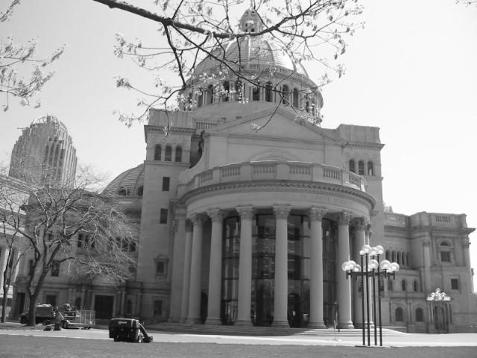
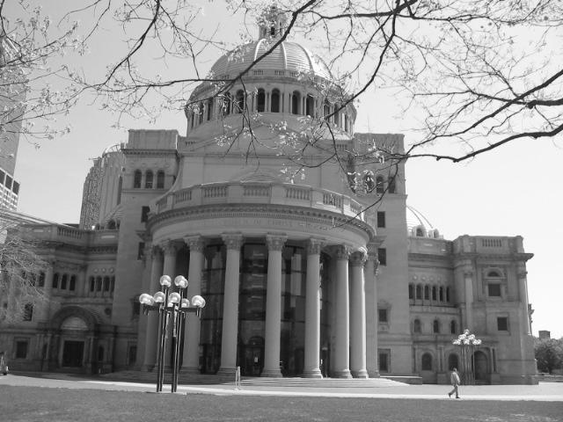
Matching local features
Kristen Grauman

Slide 56
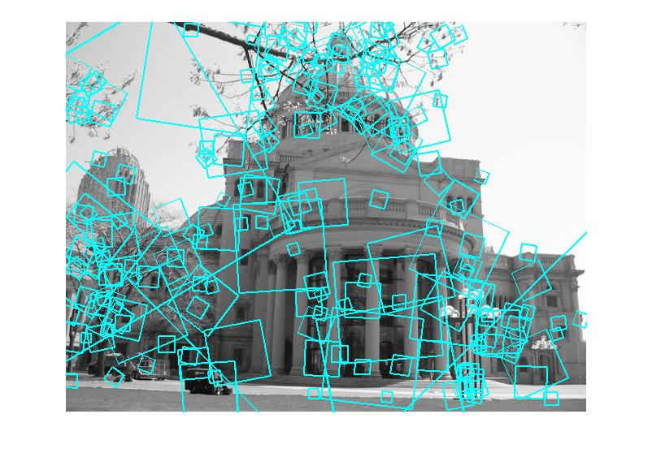
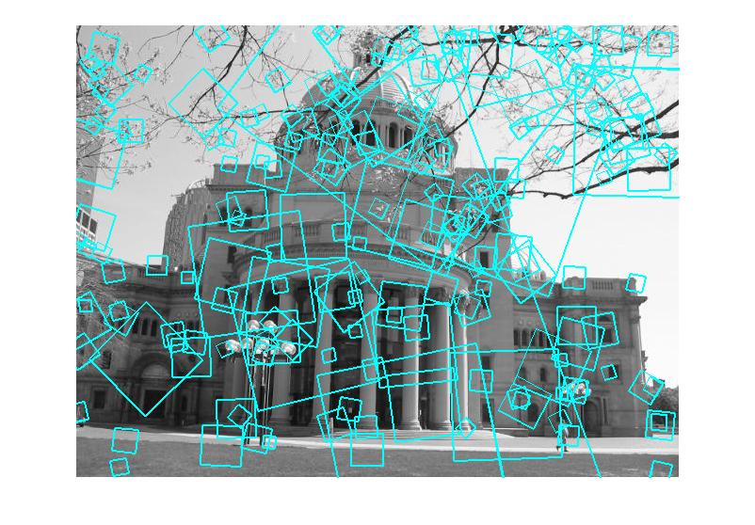
Matching local features
?
Image 1
Image 2
To generate candidate matches, find patches that have the most similar appearance (e.g., lowest SSD)
Simplest approach: compare them all, take the closest (or closest k, or within a thresholded distance)
Kristen Grauman

Slide 57




Correlation-based Similarity Measures
Sum of Squared Differences (SSD)
Sum of Absolute Differences (SAD)
Sum of Hamming Distances (SHD)
Zero-mean Sum of Squared Differences (ZSSD)
In ZSSD method the cost is determined as in SSD also by subtracting the mean of the match area from each intensity value. However, subtracting the mean from the squared intensities adds to the computational complexity of the aggregation method.

Slide 58
Ambiguous matches
?
?
?
?
Image 1
Image 2
At what SSD value do we have a good match?
To add robustness to matching, can consider ratio : distance to best match / distance to second best match
If low, first match looks good; If high, could be ambiguous match.
Kristen Grauman

Slide 59
Feature matching
Given a feature in I₁, how to find the best match in I₂?
Define distance function that compares two descriptors
Test all the features in I₂, find the one with min distance

Slide 60

Feature distance
How to define the difference between two features f₁, f₂?
Simple approach is SSD(f₁, f₂)
sum of square differences between entries of the two descriptors
can give good scores to very ambiguous (bad) matches
I₁
I₂
f₁
f₂

Slide 61
Feature distance
How to define the difference between two features f₁, f₂?
Better approach: ratio distance = SSD(f₁, f₂) / SSD(f₁, f₂’)
f₂ is best SSD match to f₁ in I₂
f₂’ is 2nd best SSD match to f₁ in I₂
gives small values for ambiguous matches
I₁
I₂
f₁
f₂'
f₂

Slide 62

Matching SIFT Descriptors
Nearest neighbor (Euclidean distance)
Threshold ratio of nearest to 2nd nearest descriptor
Lowe IJCV 2004

Slide 63


Recap: robust feature- based alignment
Source: L. Lazebnik

Slide 64

Recap: robust feature- based alignment
Extract features
Source: L. Lazebnik

Slide 65
Recap: robust feature- based alignment
Extract features
Compute putative matches
Source: L. Lazebnik

Slide 66
Recap: robust feature- based alignment
Extract features
Compute putative matches
Loop:
Hypothesize transformation T (small group of putative matches that are related by T)
Source: L. Lazebnik

Slide 67
Recap: robust feature- based alignment
Extract features
Compute putative matches
Loop:
Hypothesize transformation T (small group of putative matches that are related by T)
Verify transformation (search for other matches consistent with T)
Source: L. Lazebnik

Slide 68

Recap: robust feature- based alignment
Extract features
Compute putative matches
Loop:
Hypothesize transformation T (small group of putative matches that are related by T)
Verify transformation (search for other matches consistent with T)
Source: L. Lazebnik

Slide 69
Applications of local invariant features
Wide baseline stereo
Motion tracking
Panoramas
Mobile robot navigation
3D reconstruction
Recognition
…

Slide 70



Automatic mosaicing
http://www.cs.ubc.ca/~mbrown/autostitch/autostitch.html

Slide 71

Wide baseline stereo
[Image from T. Tuytelaars ECCV 2006 tutorial]

Slide 72




Recognition of specific objects, scenes
Schmid and Mohr 1997
Sivic and Zisserman, 2003
Rothganger et al. 2003
Lowe 2002
Kristen Grauman

Slide 73
Summary
Interest point detection
Harris corner detector
Laplacian of Gaussian, automatic scale selection
Invariant descriptors
Rotation according to dominant gradient direction
Histograms for robustness to small shifts and translations (SIFT descriptor)

